Slide 1
Back to Basics
UIUC ECON 490: Applied Machine Learning in Economics

Slide 2
Why are we doing this?
Train-test splitting
Different algorithms
Null model
Objective of Machine Learning:
PREDICT ACCURATELY

Slide 3
Train-Test Splits
Predicting new data

Slide 4
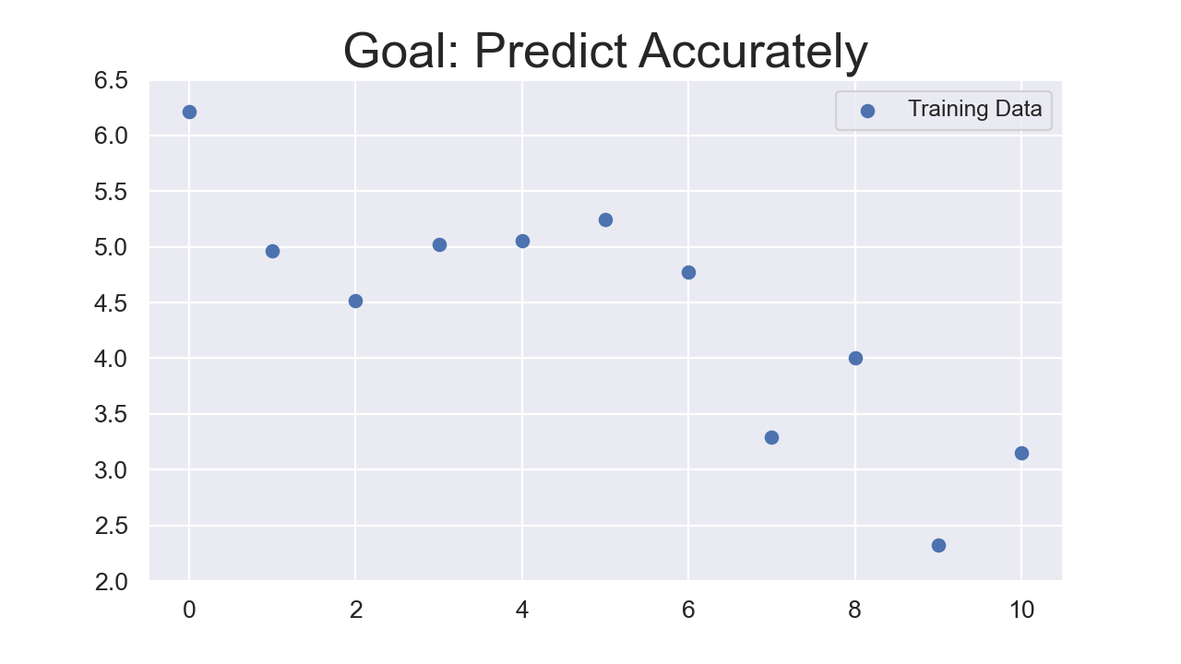
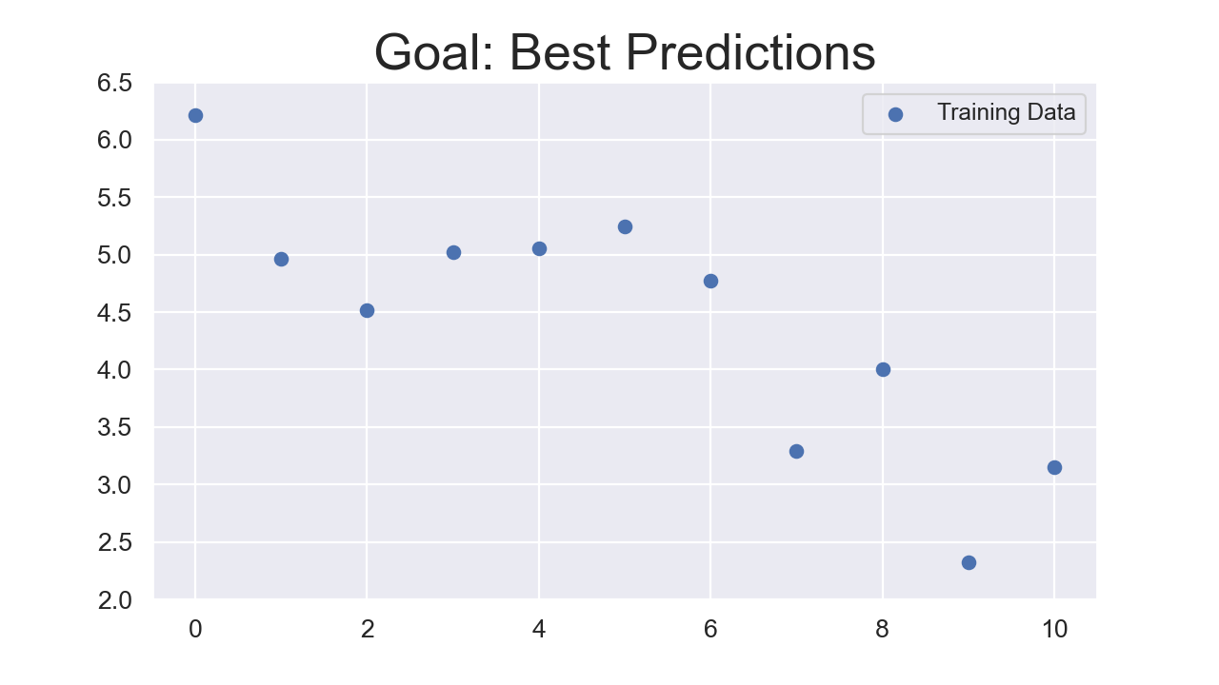
Suppose you have the data:

Slide 5
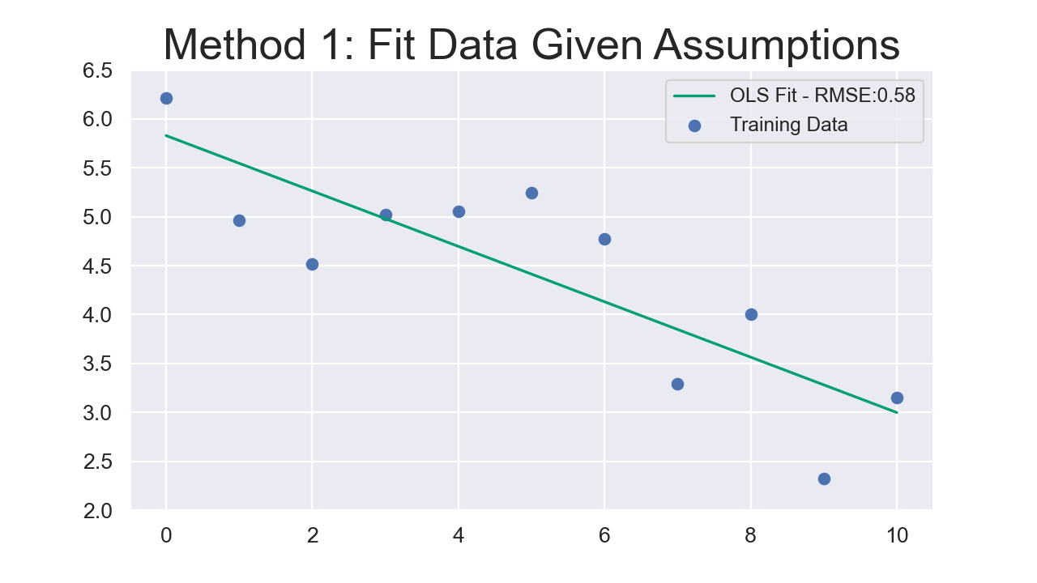
So, you predict with OLS

Slide 6
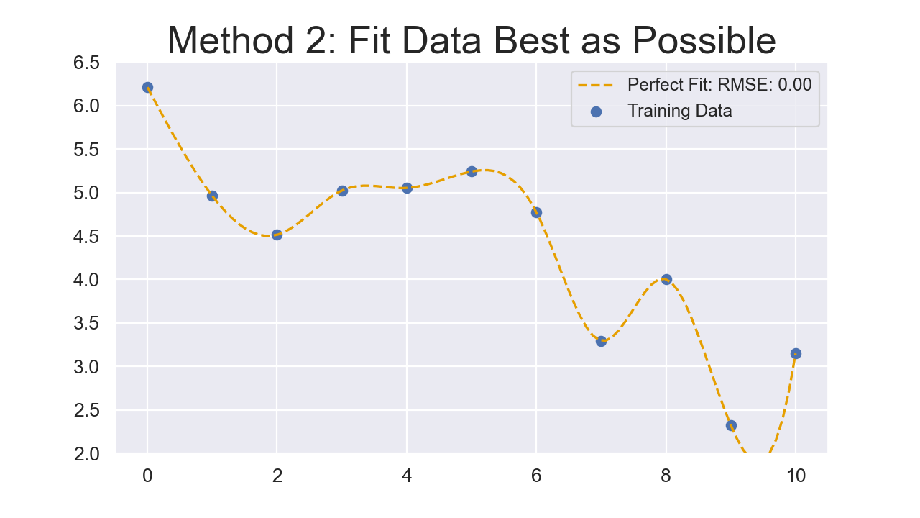
But we can do better

Slide 7
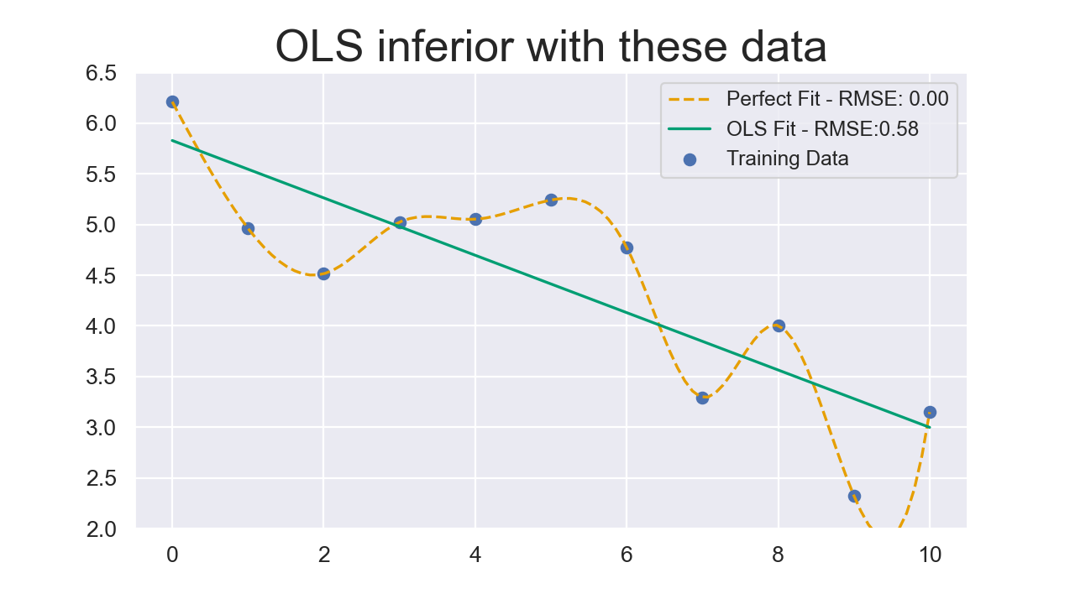
Why bother with strong OLS assumptions?

Slide 8
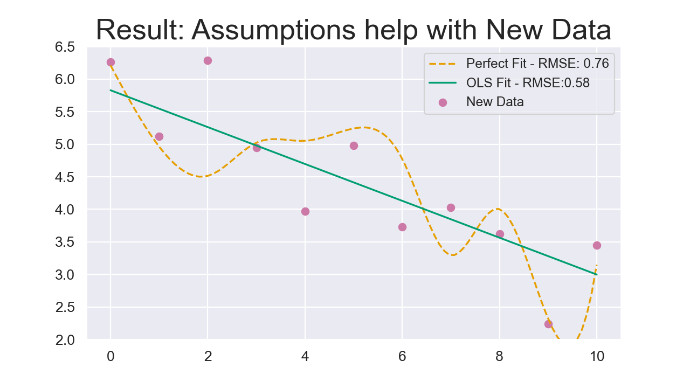
We bother for new data

Slide 9
Objective of Machine Learning
PREDICT NEW DATA ACCURATELY
Think about why we cross-validate hyperparameters with training data

Slide 10
Different Algorithms
Right tool for the data

Slide 11
Algorithms have different specialties
OLS & logistic regression
Easy patterns
Small-medium data
Predicting wages
Support Vector Machine
Complex patterns (diff. kernels)
Small data
Predicting “outliers”
Random Forests
Threshold patterns
Small-medium data
Eligibility, actions taken
Neural Networks
Complex patterns
Large data
Image recognition, voice recognition, weather predictions

Slide 12
Null Model
The weakest predictor

Slide 13
Suppose predicting ALS
Support Vector Machine: 62% accuracy
Better than a coin toss
Random Forest: 78% accuracy
Better than SVM
Neural Network: 99.6% accuracy
Best model
ALS has a 0.005% prevalence
Null Model - Always guess does not have ALS: 99.995% accuracy
Null model is the baseline - “worst you can do”

